Slide 1
Control Structures

Slide 2
Control Structures
C has the following control statements:
Sequential
Selection/Decision (if, if-else, nested if’s)
Case (switch)
Repetition/Iteration /Loop (while, do-while, for)
Jump (break, exit, goto, continue)
1-4 support structured programming,
goto – non structured

Slide 3
Simple/Compound Statements
Simple – an instruction ending with a semicolon.
Compound – several instructions grouped in a block., enclosed in braces { }.
eg. { stmt1; stmt2; stmt3; }
{ } is not required in case of simple statement.

Slide 4
The if statement
The if statement has the form:
  if (boolean-expression) statement
Examples:
  if (p ==1) printf(“Hello!");
  if (x > largest) largest = x;
The if statement controls one other statement
Often this isn’t enough; we want to control a group of statements

Slide 5
Compound statements
We can use braces to group together several statements into one “compound” statement:
  { statement; statement; ...; statement; }
Braces can group any number of statements:
  { } // OK--this is an “empty” statement
  { x = 0; } // OK--braces not required
  { temp = x;
  x = y;
  y = temp; } //typical use
The compound statement is the only kind of statement that does not end with a semicolon

Slide 6
Flowchart for the if statement
condition?
true
statement
false

Slide 7
if Statement-example with simple statement
main( )
{
int grade; //variable declaration
printf("Please input your grade:");
scanf("%d", &grade);
if( grade >= 60) /* boolean expression*/
printf("You passed the exam!\n");
    //if condition is true, print statement executed
}

Slide 8
if Statement-example with compound statement
main( )
{
int grade;
printf("Please input your grade:");
scanf("%d", &grade);
if( grade >= 60)
{
  printf("You passed the exam!\n");
  printf(“ with grade %d”,grade);
  }
}

Slide 9
The if-else statement
The if-else statement chooses which of two statements to execute
The if-else statement has the form:
if (condition)
  statement-to-execute-if-true ;
  else
  statement-to-execute-if-false ;
Either statement (or both) may be a compound statement
Notice the semicolon after each control statement.

Slide 10
Flowchart for the if-else statement
condition?
true
false
statement-1
statement-2

Slide 11
if-else Statement - example
if( grade >= 60)
{ /* compound statement */
printf("You passed "); //Executed if true
printf("the exam!\n");
}
else
{
printf("You failed!\n"); //executed if false
}

Slide 12
CLASS EXERCISE ☺
Write a program to check whether the no is divisible by 2 and 3.
2. Allow the user to enter the C.P and S.P of an item. Write a program to check whether there is profit or loss for vendor.
3. Write a program to check whether year entered is leap year or not.

Slide 13
The if Statement
Compare two numbers
  #include <stdio.h>
  int x,y;
  int main ()
  {
    printf ("\nInput an integer value for x: ");
    scanf ("%d", &x);
    printf ("\nInput an integer value for y: ");
    scanf ("%d",&y);
    if (x==y)
      printf ("x is equal to y\n");
    else if (x > y)
      printf ("x is greater than y\n");
    else
      printf ("x is smaller than y\n");
    return 0;
  }
Manav Rachna College of Engg.

Slide 14
The if Statement
Form 1:
      if (expression)
        statement1;
      next statement;
Form 2:
      if (expression)
        statement1;
      else
        statement2;
      next statement;
Form 3:
      if (expression)
        statement1;
      else if (expression)
        statement2;
      else
        statement3;
      next statement;
Execute statement1
if expression is non-zero
(i.e., it does not have to be exactly 1)
Manav Rachna College of Engg.

Slide 15
Nested if-else Statement
Grading criteria :
grade >= 90 -- A
grade >= 80 -- B
grade >= 70 – C
grade >= 60 – D
grade < 60 -- You failed

Slide 16
Nested if-else Statement
if( grade >= 90)
printf("You got an A!\n");
else if ( grade >= 80 )
printf("You got a B!\n");
else if ( grade >= 70 )
printf("You got a C!\n");
else if ( grade >= 60 )
printf("You got a D!\n");
else
printf("You failed!\n");

Slide 17
Using Logical Operators- avoid nested if-else
if( grade >= 90)
printf("You got an A\n");
if( grade >= 80 && grade < 90)
printf("You got a B\n");
if( grade >= 70 && grade < 80)
printf("You got a C\n");
if( grade >= 60 && grade < 70)
printf("You got a D\n");
if( grade < 60 )
printf("You failed!\n");

Slide 18
Logical Operators or Nested if-else Statement?
if ( expr1 && expr2 ) A; else B; | if ( expr1) { if ( expr2 ) A; else B;} else B;
if ( expr1 || expr2 ) A; else B; | if ( expr1) A; else { if ( expr2 ) A; else B;}

Slide 19
In-Class Exercise
Find the largest and smallest number among three numbers using:
  Nested if-else statement (minimum comparisons)
  Logical operators (only if statement is allowed; no else clause)

Slide 20
Multiple Selection
So far, we have only seen binary selection.
if ( age >= 18 )
{
printf(“Vote!\n”) ;
}
else
{
printf(“Not Eligible!\n”) ;
}
if ( age >= 18 )
{
printf(“Vote!\n”) ;
}

Slide 21
Multiple Selection
Sometimes it is necessary to branch in more than two directions.
We do this via multiple selection.
The multiple selection mechanism in C is the switch statement.

Slide 22
Multiple Selection with if
if (day == 4) {
printf (“Thursday”) ;
}
if (day == 5) {
printf (“Friday”) ;
}
if (day == 6) {
printf (“Saturday”) ;
}
if ((day < 0) || (day > 6)) {
printf(“Error - invalid day.\n”) ;
}
if (day == 0 ) {
printf (“Sunday”) ;
}
if (day == 1 ) {
printf (“Monday”) ;
}
if (day == 2) {
printf (“Tuesday”) ;
}
if (day == 3) {
printf (“Wednesday”) ;
}

Slide 23
Multiple Selection with if-else
if (day == 0 )
{
printf (“Sunday”) ;
} else if (day == 1 )
{
printf (“Monday”) ;
}
else if (day == 2)
{
printf (“Tuesday”) ;
}
else if (day == 3)
{
printf (“Wednesday”) ;
}
else if (day == 4)
{
printf (“Thursday”) ;
}
else if (day == 5)
{
printf (“Friday”) ;
}
else if (day = 6)
{
printf (“Saturday”) ;
}
else
{
printf (“Error - invalid day.\n”) ;
}
This if-else structure is more efficient than the corresponding if structure. Why?

Slide 24
switch Statement
Switch statement is used to do “multiple choices”.
Generic form:
  switch(expression)
  {
  case constant_expr1 : statements
  case constant_expr2 : statements
  …
  case constant_exprk : statements
  default : statements
  }
  expression is evaluated.
  The program jumps to the corresponding constant_expr.
  All statements after the constant_expr are executed until a break (or goto, return) statement is encountered.
Manav Rachna College of Engg.

Slide 25
The switch Multiple-Selection Structure
switch ( integer/char expression )
{
case constant₁ :
statement(s)
case constant₂ :
statement(s)
. . .
default:
statement(s)
}

Slide 26
switch Multiple-Selection Structure
switch ( integer/char expression )
{
case constant₁ :
statement(s)
break ;
case constant₂ :
statement(s)
break ;
. . .
default:
statement(s)
break ;
}

Slide 27
Switch-Case Structures
The switch - case syntax is:
  switch (integer expression test value)
  {
    case case _1_fixed_value :
      action(s) ;
    case case_2_fixed_value :
      action(s) ;
  default :
      action(s) ;
  }
Note use of colon!
Manav Rachna College of Engg.

Slide 28
Switch-Case Structures
The switch is the "controlling expression"
  Can only be used with constant integer expressions.
  Remember, a single character is a small positive integer.
  The expression appears in ( )
The case is a "label"
  The label must be followed by a " : "
  Braces, { }, not required around statements
Manav Rachna College of Engg.

Slide 29
Switch flowchart
entry
Expression?
value1
value2
value3
value4
Value n
Statement(s)
Statement(s)
Statement(s)
Statement(s)
Statement(s)

Slide 30
Flowchart- Switch Statement
true
case a
case a action(s)
break
false
true
case b
case b action(s)
break
false
.
.
.
true
Manav Rachna College of Engg.
case z
case z action(s)
break
false
default action(s)

Slide 31
switch Example
switch ( day )
{
case 0: printf (“Sunday\n”) ;
case 1: printf (“Monday\n”) ;
case 2: printf (“Tuesday\n”) ;
case 3: printf (“Wednesday\n”) ;
case 4: printf (“Thursday\n”) ;
case 5: printf (“Friday\n”) ;
case 6: printf (“Saturday\n”) ;
default: printf (“Error -- invalid day.\n”) ;
}
Is this structure more efficient than the equivalent nested if-else structure?

Slide 32
Switch-Case Example
switch ( day )
{
case 0: printf (“Sunday\n”) ;
break ;
case 1: printf (“Monday\n”) ;
break ;
case 2: printf (“Tuesday\n”) ;
break ;
case 3: printf (“Wednesday\n”) ;
break ;
case 4: printf (“Thursday\n”) ;
break ;
case 5: printf (“Friday\n”) ;
break ;
case 6: printf (“Saturday\n”) ;
break ;
default: printf (“Error -- invalid day.\n”) ;
break ;
}

Slide 33
switch Statement Details
Note: The last statement of each case in the switch should almost always be a break.
The break causes program control to jump to the closing brace of the switch structure.
Without the break, the code flows into the next case. This is almost never what you want.
A switch statement will compile without a default case, but always consider using one.

Slide 34
Good Programming Practices
Include a default case to catch invalid data.
Inform the user of the type of error that has occurred (e.g., “Error - invalid day.”).
If appropriate, display the invalid value.
If appropriate, terminate program execution using exit().

Slide 35
Why Use a switch Statement?
A nested if-else structure is just as efficient as a switch statement.
However, a switch statement may be easier to read.
Also, it is easier to add new cases to a switch statement than to a nested if-else structure.

Slide 36
goto Statement
int grade;
loop: /* label */
printf("Please input your grade:");
scanf("%d", &grade);
if (grade <0) goto exit;
if( grade >= 60)
printf("You passed the exam!\n");
goto loop; /* label */
exit:
printf(“out of program!!”);
Avoid using GOTO!!!

Slide 37
The while Statement
Generic Form
  while (condition)
  statement
Executes as expected:
  condition is evaluated
  If condition is false (i.e. 0), loop is exited (go to step 5)
  If condition is true (i.e. nonzero), statement is executed
  Go to step 1
  Next statement
Manav Rachna College of Engg.

Slide 38
The while Repetition Structure
Flowchart of while loop
true
condition
statement
false
Manav Rachna College of Engg.

Slide 39
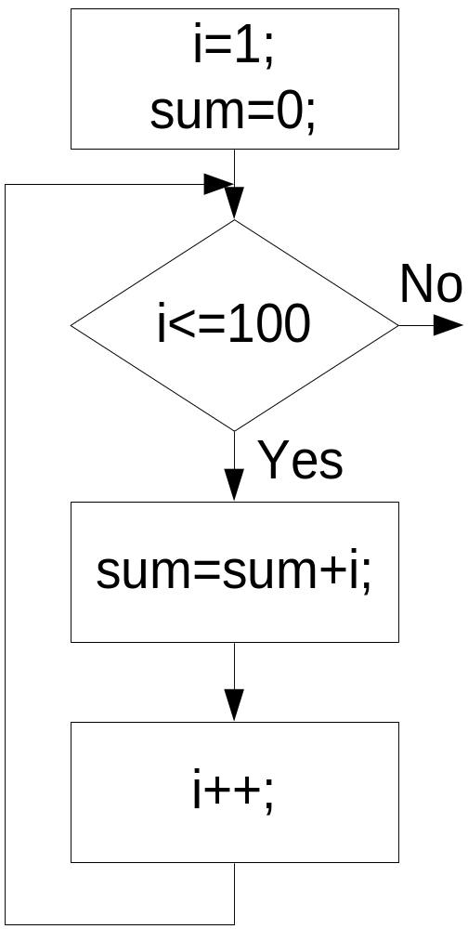
Sum from 1 to 100 (while)
START
int i=1,sum=0;
while(i<=100)
{
sum=sum+i;
i++;
}
END

Slide 40
CLASS EXERCISE ☺
Write a program to print hello 5 times.
Write a program to print hello n times.
Write a program to print sum of first n numbers.

Slide 41
The do ... while Loop
Generic Form:
  do
  statement
  while (condition);
Standard repeat until loop
    Like a while loop, but with condition test at bottom.
    Always executes at least once.
The semantics of do...while:
  Execute statement
  Evaluate condition
  If condition is true go to step 1
  Next statement
Manav Rachna College of Engg.

Slide 42
The do/while Repetition Structure
The do/while repetition structure is similar to the while structure,
  Condition for repetition tested after the body of the loop is executed
Format:
    do {
    statement
    } while ( condition );
Example (letting counter = 1):
    do {
    printf(“%d”,counter);
    } while (++counter <= 10);
  This prints the integers from 1 to 10
All actions are performed at least once.
statement
true
condition
Manav Rachna College of Engg.
false

Slide 43
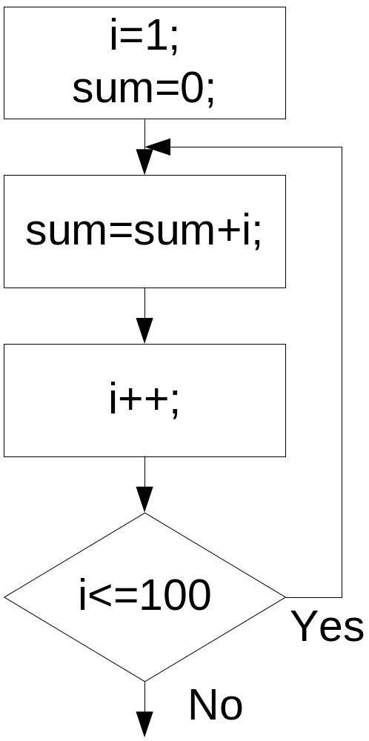
Sum from 1 to 100 (do-while)
int i=1,sum=0;
do{
sum=sum+i;
i++;
} while (i<=100);

Slide 44
CLASS EXERCISE ☺
Write a program to calculate factorial of an inputted number.
Write a program to calculate power of a number raised to another number.

Slide 45
The for Statement
The most important looping structure in C.
Generic Form:
  for (initial ; condition ; increment )
  statement
initial, condition, and increment are C expressions.
For loops are executed as follows:
  initial is evaluated. Usually an assignment statement.
  condition is evaluated. Usually a relational expression.
  If condition is false (i.e. 0), fall out of the loop (go to step 6.)
  If condition is true (i.e. nonzero), execute statement
  Execute increment and go back to step 2.
  Next statement
Manav Rachna College of Engg.

Slide 46
Flowchart for for-loop
Initialize variable
Condition
Test the variable
true
statement
Increment variable
false
Manav Rachna College of Engg.

Slide 47
Note:
  for ( ; condition ; )
  stmt;
  is equivalent to
  while (condition)
  stmt;
  ______________________________________________________________________________________________________
  for (exp1; exp2; exp3)
  stmt;
  is equivalent to
  exp1;
  while(exp2)
  {
  stmt;
  exp3;
  }

Slide 48
Sum from 1 to 100 (for)
int i,sum;
for(i=1,sum=0;i<=100;i++)
sum=sum+i;

Slide 49
CLASS EXERCISE ☺
Write a program to calculate the sum of digits of an inputted number.
Write a program to calculate reverse of an inputted number.

Slide 50
break and continue
The flow of control in any loop can be changed through the use of the break and continue commands.
break:
The break command exits the loop immediately.
  Useful for stopping on conditions not controlled in the loop condition.
  For example:
      for (x=0; x<10000; x++)
      {
      if ( x% 5==1) break;
      ... do some more work ...
      }
  Loop terminates if x % 5 == 1
Manav Rachna College of Engg.

Slide 51
CLASS EXERCISE ☺
Write a program to check whether inputted number is a prime number or not.

Slide 52
break and continue
continue :
The continue command causes the next iteration of the loop to be started immediately.
  For example:
      for (x=0; x<10000; x++)
      {
      if (x% 5 == 1) continue;
      printf( "%d ", x );
      }
  Don't execute loop when x% 5 == 1.
Manav Rachna College of Engg.

Slide 53
break and continue
Compare the output in the following code segments:
int i;
for(i=1;i<=10;i++)
{
if(i==5)break;
printf("%d ",i);
}
int i;
for(i=1;i<=10;i++)
{
if(i==5)continue;
printf("%d ",i);
}

Slide 54
Flowchart for break.
Continuation
false
condition?
true
Statement(s)
break
Statement(s)
Next
Statement

Slide 55
Flowchart for continue
.
false
Continue
condition?
true
Statement(s)
continue
Statement(s)
Next
Statement

Slide 56
The for Statement
Nesting for Statements
  for statements (and any other C statement) can go inside the loop of a for statement.
  For example:
    main( )
    {
    int r, c;
    for ( r=1 ; r<=10 ; r++)
    {
    for (c = 1; c<=r; c++)
    printf (“*");
    printf ("\n");
    }
    }
*
* *
* * *
* * * *
* * * * *
Manav Rachna College of Engg.

Slide 57
Nested Structure
int i,j;
for(i=1;i<=10;i++)
{
for(j=1;j<=i;j++)
printf("*");
printf("\n");
}

Slide 58
Ur Turn ☺
Create the following pattern using loops (while & for loop)
1) *
* *
* * *
* * * *
2) 5 5 5 5 5
4 4 4 4
3 3 3
2 2
1
Manav Rachna College of Engg.

Slide 59
Ur Turn ☺
Create the following pattern using loops
3) 1
1 2
1 2 3
1 2 3 4
4) 1
1 2 1
1 2 3 2 1
1 2 3 4 3 2 1
Manav Rachna College of Engg.

Slide 60
Jumping Out of Nested Loops - goto statement
The goto statement will jump to any point of your program.
Use only if it is absolutely necessary
  for(;;)
  {
  ……
  while(…)
  {
  switch(…)
  {
  ……
  case … : goto finished; /* finished is a label */
  }
  }
  }
  finished: /* Jumped out from the nested loops */
Never jump into a loop!
Never jump backward!
Manav Rachna College of Engg.

Slide 61
goto Statement
int grade;
loop: /* label */
printf("Please input your grade:");
scanf("%d", &grade);
if (grade <0) goto exit;
if( grade >= 60)
printf("You passed the exam!\n");
goto loop; /* label */
exit:
printf(“out of program!!”);
Avoid using GOTO!!!

Slide 62
TIME TO THINK????
Which of the following statement is not true about the switch statement
(a) Character constants are automatically converted into integer
(b) No two case statements have identical constants in the same switch
(c) The switch() can evaluate relational or logical expressions
(d) In switch() case statement nested if can be used
Which of the following is not correct
(a) while loop is executed only if the condition is true
(b) do . while loop is executed at least once
(c) while loop is executed at least once
(d) do while loop is executed only if the condition is true
Identify the wrong statement:
(a) if (a<b) {; }
(b) if (a<b);
(c) if (a >b) {; ; }
(d) if a<b;

Slide 63
TIME TO THINK!!!!!
What is the output for the following program
main( )
{ int m=5,y;
y=++m;
printf(“%d,%d”m,y);
}
(a) 7,5
(b) 5,6
(c) 6,6
(d) 5,5
int x=1,y=5;
x=++x + --y;
what is the value of x
(a) 7
(b) 8
(c) 6
(d) 5
Manav Rachna College of Engg.

Slide 64
Which one of the following is not a loop control structure.
(a) do-while
(b) for
(c) if
(d) while
Assume all variable are declared What is the output of the following code.
count = 0;
while (count != 100);
{ count = 1;
sum = sum + x;
count = count + 1;
}
(a) Error
(b) It will give count as 10
(c) it will give the sum of 1st10 natural numbers
(d) It is in infinite loop
Manav Rachna College of Engg.

